Slide 1
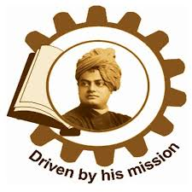
SWAMI VIVEKANANDA INSTITUTE OF SCIENCE AND TECHNOLOGY
OPTICAL CHARACTER RECOGNITION SYSTEM FOR ENGLISH LANGUAGE
MENTOR: DR. SRIKANTA PAL
GROUP MEMBERS:
DEBAPROTO MUKHERJEE(24100115018)
SAYANI CHAKRABORTY(24100115043)
ANIK DAS(24100115006)
SUJASH SAHA(24100115051)
ABHIJEET KUMAR KUSHWAHA(24100115001)

Slide 2
CONTENTS
Introduction
Objective
Software Setup
Working Principle of OCR
Code
Experimentation
Errors
Result Analysis
Conclusion
Acknowledgement
Conclusion

Slide 3
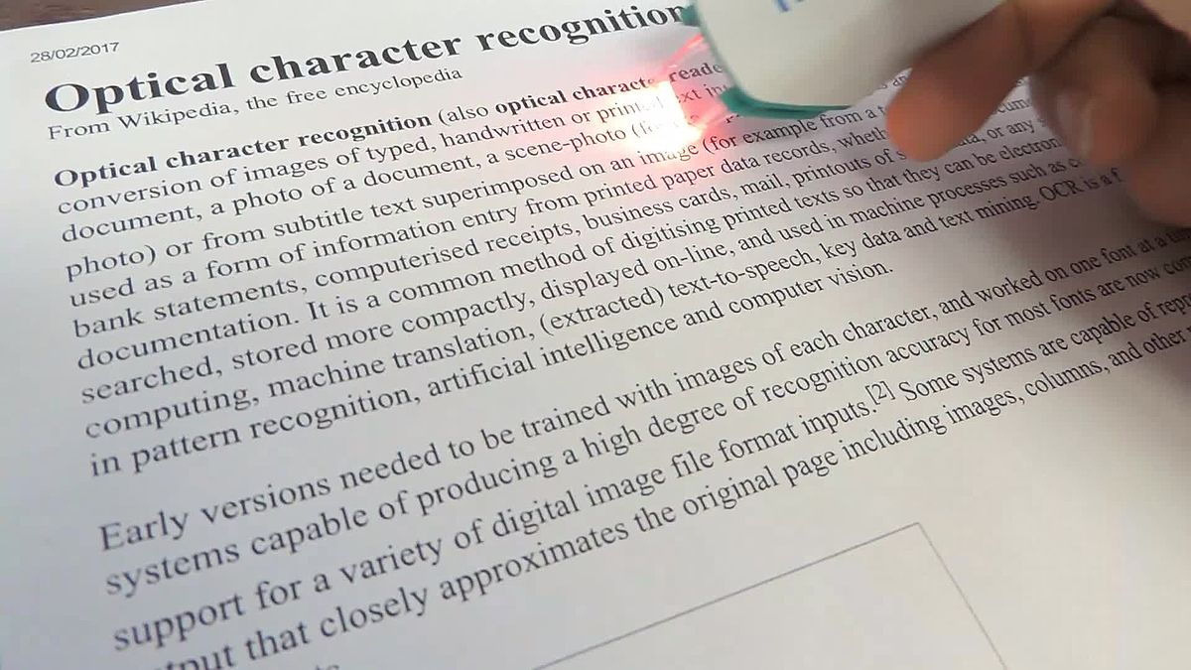
INTRODUCTION
Optical character recognition ( OCR) is the mechanical or electronic conversion of images of typed, handwritten or printed text into machine-encoded text, whether from a scanned document, a photo of a document, a scene-photo (for example the text on signs and billboards in a landscape photo) or from subtitle text superimposed on an image (for example from a television broadcast).

Slide 4
OBJECTIVE
Our program produces raw text from an image document which can be used for multiple purposes.
Here, raw text is converted to audio for visually impaired persons.
Raw text can also be used in offices for avoiding retyping hassle, thus increasing the throughput.

Slide 5
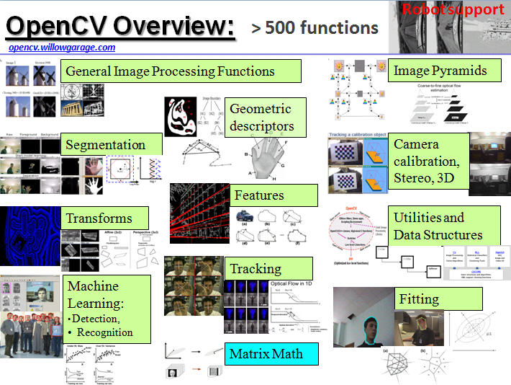
SOFTWARE SETUP
OpenCV
(Open source computer vision) is a library of programming functions mainly aimed at real-time computer vision. Originally developed by Intel, it was later supported by Willow Garage then Itseez (which was later acquired by Intel). The library is cross-platform and free for use under the open-source BSD license.
pip install opencv-python

Slide 6
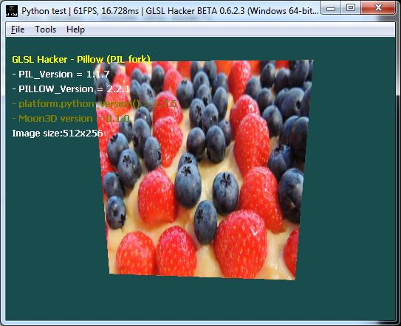
Pillow Library
(Python Imaging Library) Python Imaging Library (abbreviated as PIL) (in newer versions known as Pillow) is a free library for the Python programming language that adds support for opening, manipulating, and saving many different image file formats.
pip install Pillow

Slide 7

3) PyTesseract
Python-tesseract is a wrapper for Google’s Tesseract-OCR Engine. It is also useful as a stand-alone invocation script to tesseract, as it can read all image types supported by the Python Imaging Library. Additionally, if used as a script, Python-tesseract will print the recognized text instead of writing it to a file.
1) Installing wrapper for Tesseract:
pip install pytesseract
2) Installing PyTesseract Binary File
pip install -U git+https://github.com/madmaze/pytesseract.git
3) PyTesseract Source Code
https://github.com/tesseract-ocr/tesseract

Slide 8
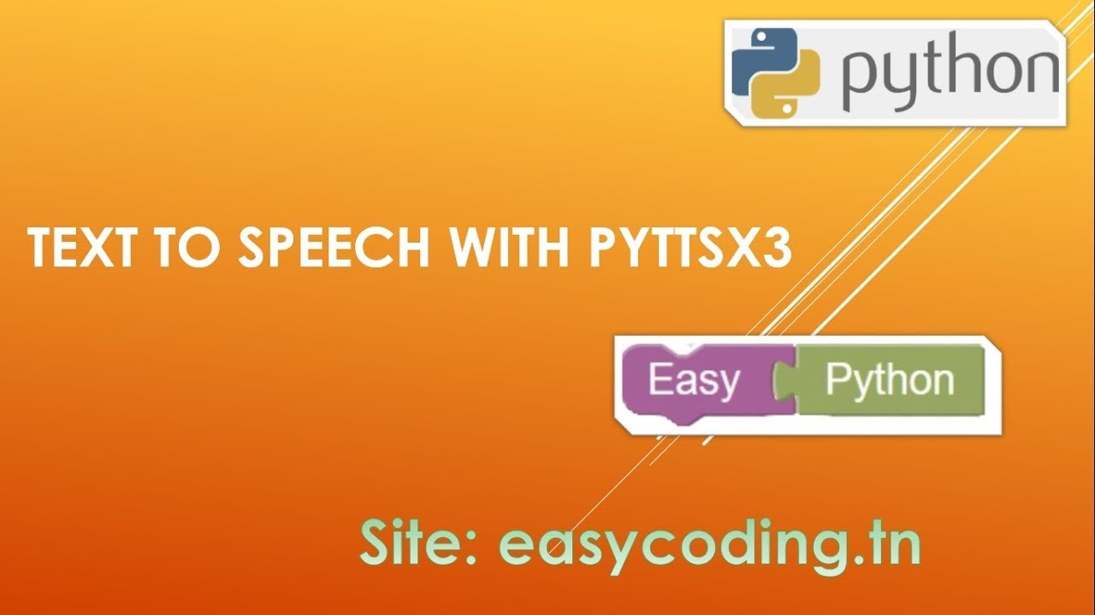
4) pyttsx3
pyttsx3 is a text-to-speech conversion library in Python. Unlike alternative libraries, it works offline, and is compatible with both Python 2 and 3.
pip install pyttsx3

Slide 9

5) NumPy
NumPy is a general-purpose array-processing package. It provides a high-performance multidimensional array object, and tools for working with these arrays.
python -m pip install numpy

Slide 10
WORKING PRINCIPLE OF OCR
Binarize the input Image

Slide 11
Removing Image elements
(a) Text Portion (b) Image elements.

Slide 12
Outline image to Blobs

Slide 13
Blobs to Text Lines

Slide 14

Word Extraction from Line
a) Baseline Fitting
Once the text lines have been found, the baselines are fitted more precisely using a quadratic spline.
An example of a curved fitted baseline.
b) Fixed Pitch Detection and Chopping
Tesseract tests the text lines to determine whether they are fixed pitch. Where it finds fixed pitch text, Tesseract chops the words into characters using the pitch
A fixed-pitch chopped word.

Slide 15
c) Word Recognition
Part of the recognition process for any character recognition engine is to identify how a word should be segmented into characters. The initial segmentation output from line finding is classified first. The rest of the word recognition step applies only to non-fixed pitch text.
d) Adaptive Classifier
A more font-sensitive adaptive classifier that is trained by the output of the static classifier is therefore commonly used to obtain greater discrimination within each document, where the number of fonts is limited.

Slide 16
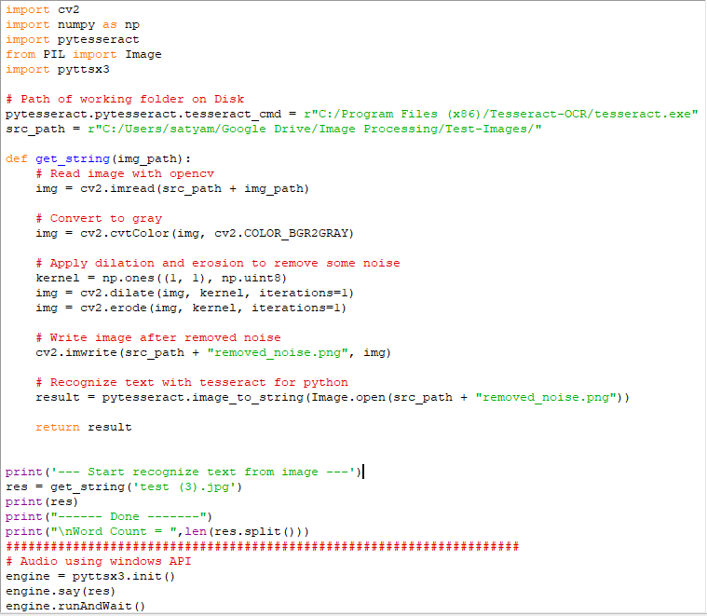
CODE

Slide 17
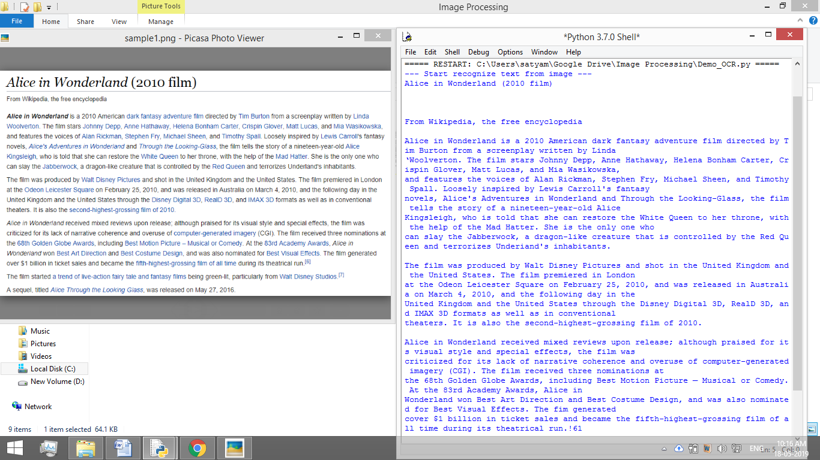
EXPERIMENTATION
Image sample-1 with output

Slide 18
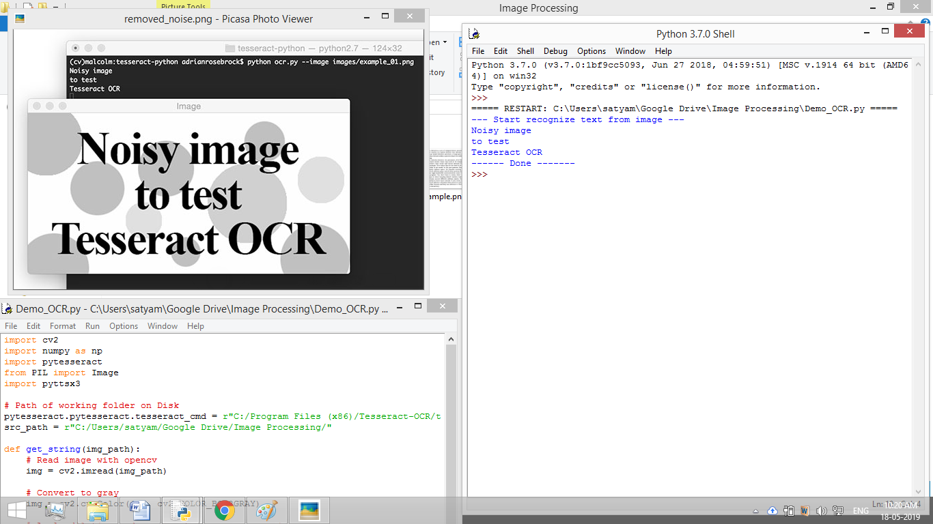
Image sample-2 with output

Slide 19
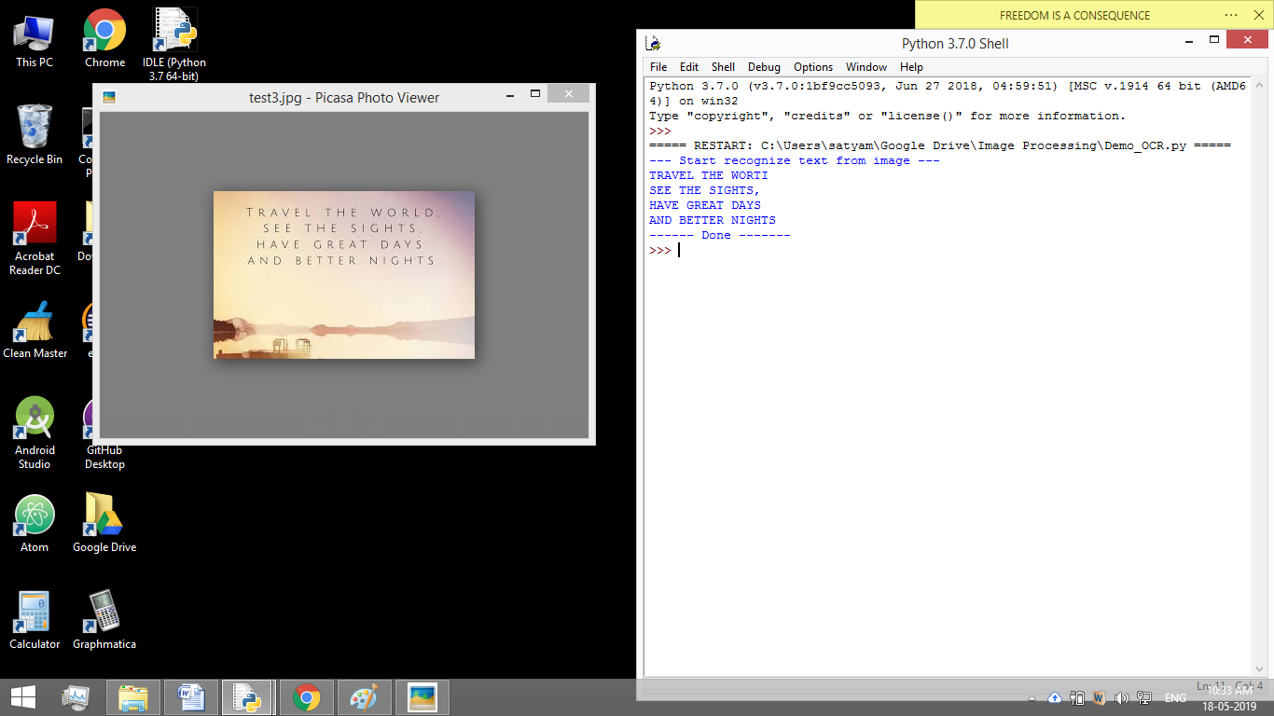

Slide 20
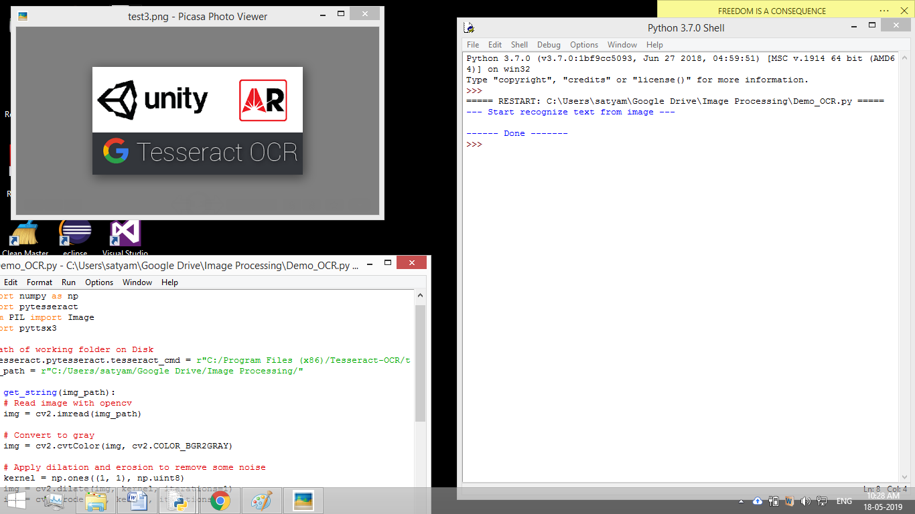
ERRORS
Image sample-1 with output

Slide 21
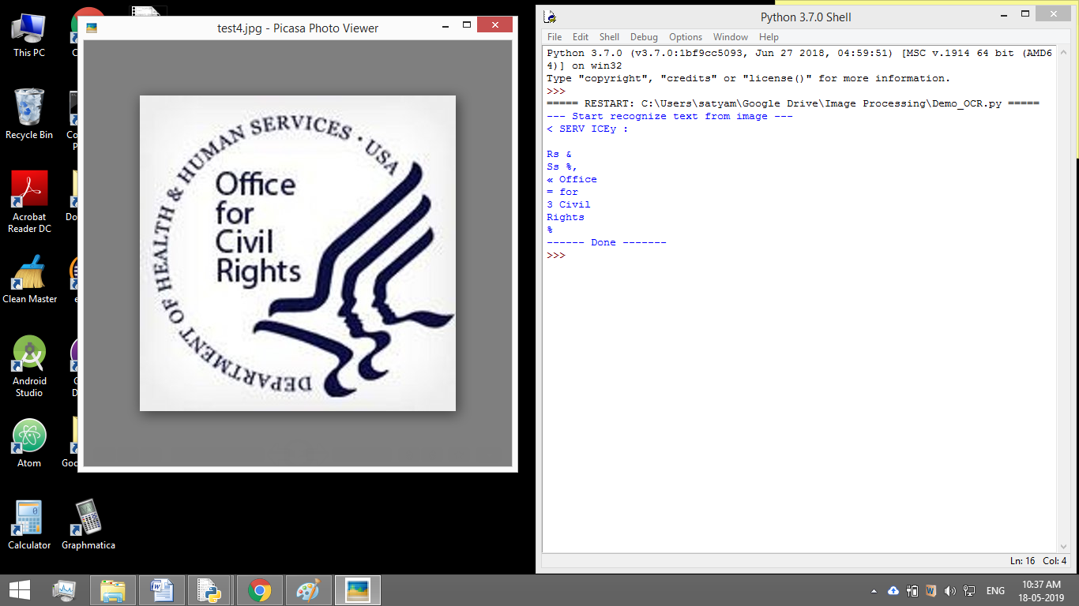
Image sample-2 with output

Slide 22
RESULT ANALYSIS
S.L. no | Resolution | Input Image Words | Output Correct Words | Accuracy Percentage
1 | 280x180 | 12 | 11 | 91.67
2 | 314x161 | 3 | 0 | 0
3 | 400x400 | 10 | 4 | 40
4 | 768x340 | 152 | 152 | 100
5 | 600x386 | 239 | 239 | 100
6 | 600x381 | 6 | 6 | 100
7 | 856x494 | 340 | 340 | 100
8 | 626x580 | 128 | 201 | 57.03
9 | 259x194 | 60 | 60 | 100
10 | 225x225 | 1 | 0 | 0
11 | 550x332 | 107 | 0 | 0
12 | 268x184 | 4 | 4 | 100
13 | 977x297 | 34 | 34 | 100
14 | 291x173 | 40 | 31 | 77.5
15 | 468x423 | 82 | 82 | 100
16 | 359x140 | 51 | 51 | 100
17 | 850x240 | 56 | 56 | 100
18 | 292x172 | 52 | 0 | 0
19 | 569x183 | 7 | 7 | 100
20 | 259x194 | 70 | 53 | 75.71
21 | 376x265 | 20 | 20 | 100
22 | 400x533 | 13 | 4 | 30.77
23 | 383x132 | 21 | 5 | 23.80
24 | 960x720 | 54 | 54 | 100
25 | 259x194 | 55 | 50 | 90.91
Here, a sample of 25 random pictures are tested and the average accuracy of
71.5% is found.

Slide 23
CONCLUSION
The project can be used for various purposes.
Converting books to e-books
Making e-books audible
OCR in cloud services
Work is being done to implement an Android app which can convert images from camera to text.

Slide 24
ACKNOWLEDGEMENT
We take this opportunity to express our profound gratitude and deep regards to Dr. Srikanta Pal and our faculties for their explanatory guidance, monitoring and constant encouragement throughout the course of this project. The blessing, help and guidance given by them time to times has carried us a long way .
We are obliged to my project team members for the valuable information provided by them in their respective fields. I am grateful for their cooperation during the period of my assignment.

Slide 25
REFERENCES
Ray Smith , Google , An Overview of the Tesseract OCR Engine Inc.
RaySmith, Google, Hybrid Page Layout Analysis via Tab-Stop
Detection
F. Wahl, K. Wong, R. Casey, "Block segmentation and text extraction in mixed text/image documents," Computer Graphics and Image Processing

